Slide 1

Digital Mental Health Check-up

Slide 2
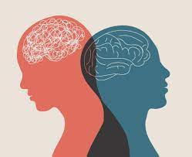
Mental health refers to the state of our psychological and emotional well-being. It encompasses a range of factors that impact our mental well-being, including our thoughts, feelings, behaviors, and social interactions.
Mental health is important for all individuals as it affects how we think, feel, and act. It influences how we perceive ourselves and the world around us, as well as our ability to cope with stress, overcome challenges, and form meaningful relationships.

Slide 3

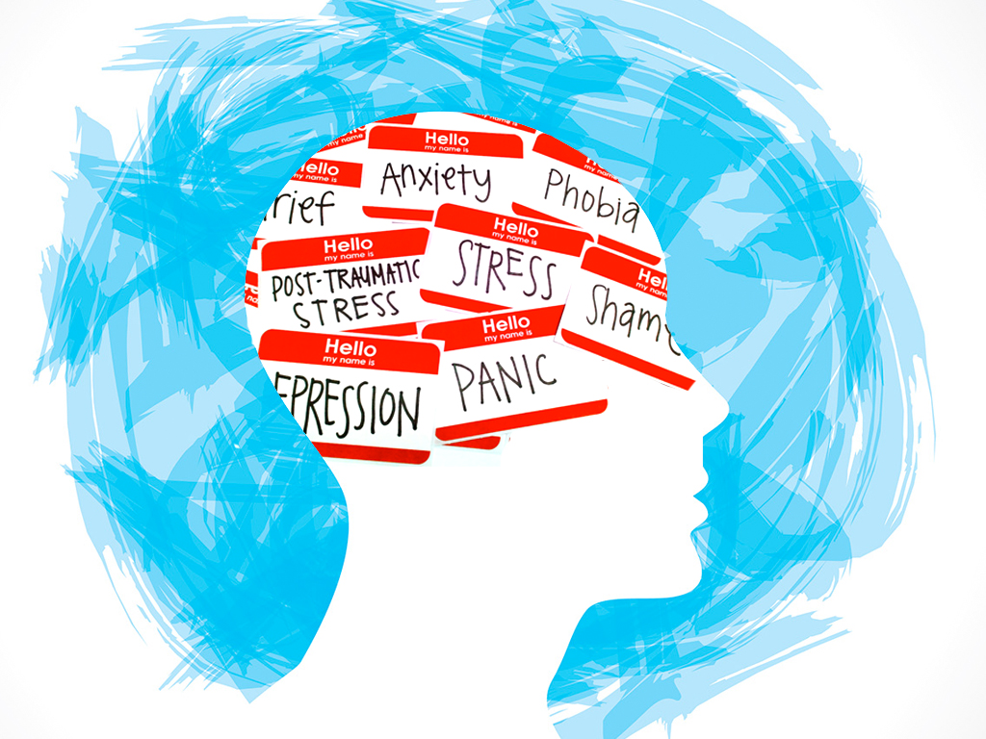
Mental health problems can be caused by a variety of factors, such as genetic predisposition, traumatic experiences, environmental factors, and lifestyle choices. Common mental health disorders include anxiety disorders, depression, bipolar disorder, schizophrenia, and eating disorders.

Slide 4
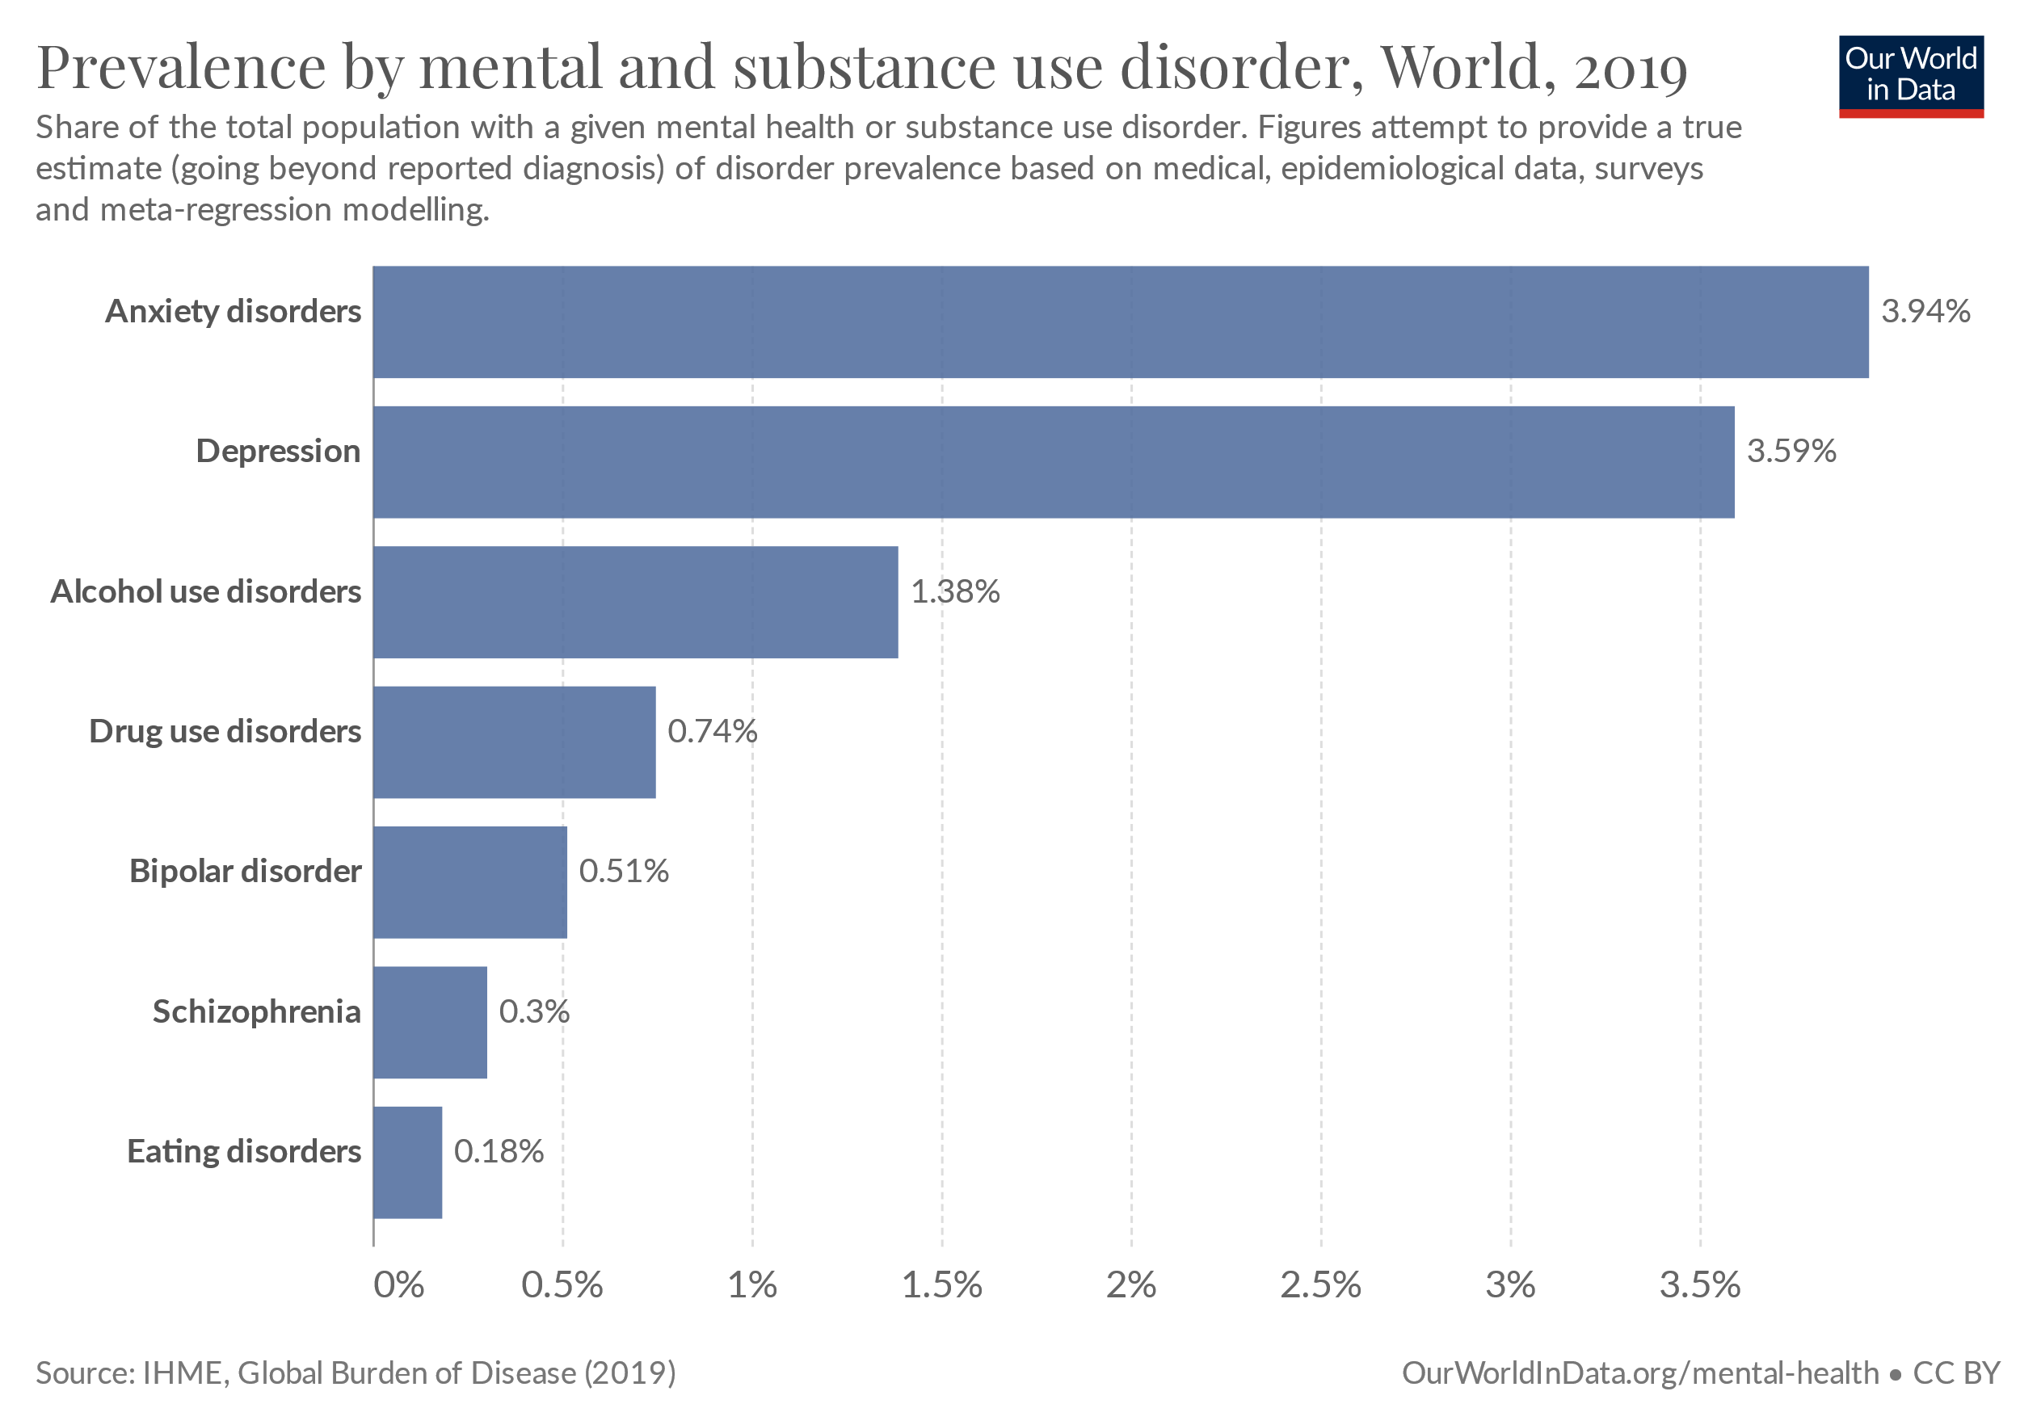

Slide 5
Documentation
Problem Statement :
Mental health refers to the state of our psychological and emotional well-being and we find many people around us who suffer from mental health issue and they don’t know how to come out of that. Here in this project we have come up with solution by just asking some simple questions and by the response of user we will calculate his\her mental status. Our project will also suggest some solution of their problem regarding their response to the questions asked by our project executer.

Slide 6
Solution Track:
Our project is based on some fixed type of response given by user. It is a Manu driven program where it has classified major mental status into seven categories. User will first select their problem based on their status from the category mentioned on their screen. For Example if a user presses “1” then he\she will be pass to the question bank of anxiety and their they have to give response in 0 or 1 means True or False. After the response it will automatically calculate and based on that it will suggest some solutions. All the Information's are mostly collected via internet and with teammates we have developed the solution of mental health.

Slide 7


Slide 8
Team HakerGen

